Slide 1
Class Design

Slide 2
Overview of Class Design
The purpose of the class design is to complete the definitions of the classes and associations and choose algorithms for operations
class design involves the following steps
Bridging the gap
Realizing Use Cases
Designing Algorithms
Recursing Downward
Refactoring
Design Optimization
Reification of Behavior
Adjustment of Inheritance
Organizing a Class Design

Slide 3
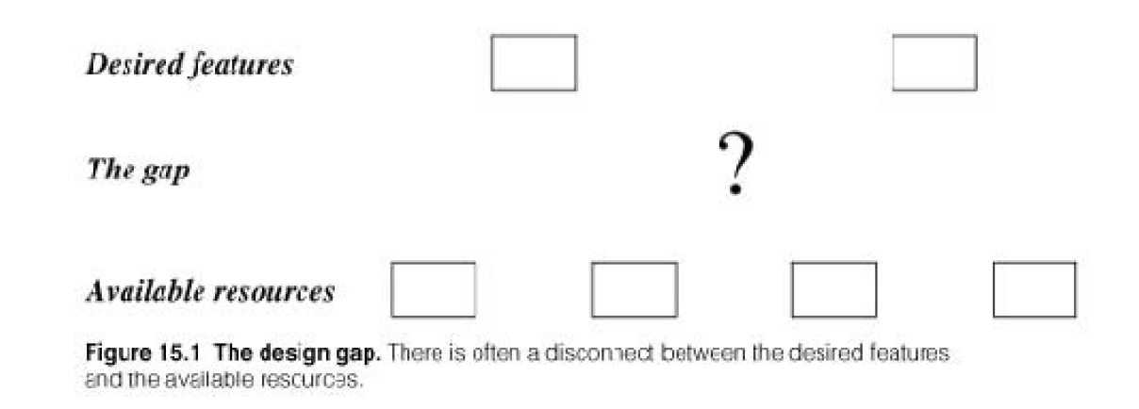
Bridging the gap
Bridge the gap from high-level requirements to low-level services
several sources of high-level needs such as application command, system operations and services

Slide 4
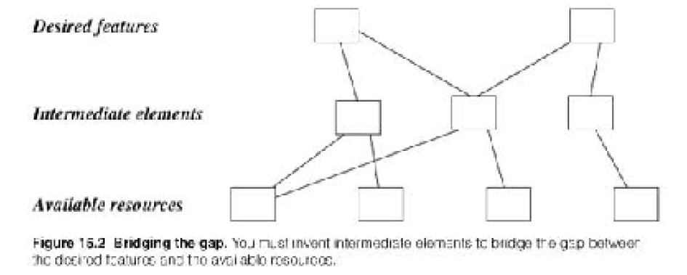
Bridging the gap
Salesman can use a spreadsheet to construct formula for his commission
Web-based ordering system

Slide 5
Realizing Use Cases
Realize use cases with operations, and system-level behavior
Step1: List the responsibilities of a use case or operation
For Example: An online theater ticket system
Step2: Each operation will have various responsibilities, Group the responsibilities into clusters
Step3: Define an operation for each responsibility cluster
For Example: Deposit, Transfer

Slide 6
Designing Algorithms
Formulate an algorithm for each operation
Designing Algorithms- steps
Choose algorithms that minimize the cost of implementing operations
Select data structures appropriate to the algorithms
Define new internal classes and operations as necessary
Assign operations to appropriate classes

Slide 7
Choosing algorithms
When efficiency is not an issue, you should use simple algorithms
Typically, 20% of the operations consume 80% of execution time
Computational complexity: how does processor time increases as a function of data structure size?
Ease of implementation and understandability: Is it worth giving up some performance on noncritical operations so as to use simple algorithm?
Flexibility

Slide 8
Choosing Data Structures
Algorithms require data structures on which to work
They organize information in a form convenient for algorithms
Many of these data structures are instances of container classes
Such as arrays, lists, queues, stacks, set…etc

Slide 9
Defining New Internal Classes and Operations
To invent new, low-level operations during the decomposition of high-level operations
low-level operations include shopping list, bill to be paid list
The expansion of algorithms may lead you to create new classes of objects to hold intermediate results

Slide 10
Recursing Downward
To organize operations as layers, Operations in higher layers invoke operations in lower layers
Two ways of downward recursion: By functionality, By mechanism
Functionality Layers
Take the required high-level functionality and break it into lesser operations
Make sure you combine similar operations and attach the operations to classes

Slide 11
Recursing Downward
Mechanism Layers
These mechanisms don’t show up explicitly in the high-level responsibilities of a system, but they are needed to make it all work
E.g. Computing architecture includes, Data structures, algorithms, and control patterns.

Slide 12
Refactoring
Changes to the internal structure of software to improve its design without altering its external functionality
You must revisit your design and rework the classes and operations so that they satisfy all their uses and are conceptually sound
Example: Account.credit(amount), Account.debit(amount) Combine into Account.post(amount)

Slide 13
Design Optimization
To design a system is to first get the logic correct and then optimize it.
Often a small part of the code is responsible for most of the time or space costs
It is better to focus optimization on the critical areas, than to spread effort evenly
You must strike an appropriate balance between efficiency and clarity

Slide 14
Design Optimization
Tasks to optimization
Provide efficient access paths
Rearrange the computation for greater efficiency
Save intermediate results to avoid recomputation
Adding Redundant Associations for Efficient Access
Rearrange the associations to optimize critical aspects of the system
Consider employee skills database

Slide 15
Design Optimization
For each operation, consider the following
Frequency of access: how often is the operation called?
Fan-out: estimate the multiplicity encountered along the path
Selectivity: objects that meet selection criteria and are operated on

Slide 16
Design Optimization
Rearranging Execution Order for Efficiency
After adjusting the structure of class model to optimize frequent traversals, the next thing is to optimize the algorithm
i. To eliminate dead paths as early as possible
ii. To narrow the search as soon as possible
iii. Sometimes, invert the execution order of a loop

Slide 17
Design Optimization
Saving Derived Values to Avoid Recomputation
Explicit update: designer inserts code into update operation of source attributes to explicitly update
Periodic recomputation: recompute all the derived attributes periodically, instead of after each source change
Active Values: value that is automatically consistent with its source value

Slide 18
Reification behavior
Promotion of something that is not an object into object
Behavior written in code is rigid; you can execute but cannot manipulate it at run time
If you need to store, pass, or modify the behavior at run time, you should reify it
Reification adds complexity but can dramatically expand the flexibility of a system
Example : ATM cash withdrawal, deposit in ATM machine

Slide 19
Adjustment of Inheritance
To increase inheritance perform the following steps
Rearrange classes and operations to increase inheritance
Abstract common behavior out of groups of clusters
Use delegation to share behavior when inheritance is semantically invalid

Slide 20
Rearrange classes and operations to increase inheritance
Operations with optional arguments: able to align signatures by adding optional arguments that can be ignored. Ex: draw argument on a monochromatic display
Operations that are special cases: some operations may have fewer arguments because they are special cases of more general operations
Inconsistent names: similar attributes in different classes may have different names.
Irrelevant operations: several classes in a group may define an operation, but some others may not

Slide 21
Abstract common behavior out of groups of clusters
When there is common behavior, you can create a common superclass for the shared features, leaving only the specialized features in the subclasses.
example: draw() operation of a geometric fig on a display screen requires setup and rendering of the geometry.
The rendering varies among different figures, such as circles, lines and splines, but the fig can inherit the setup

Slide 22
Use delegation to share behavior
When class B inherits the specification of class A, you can assume that every instance of class B is an instance of class A
One object can selectively invoke the desired operations of another class, using delegation rather than inheritance
Delegate only meaningful operations, so there is no danger of inheriting meaningless operations by accident

